Slide 1
Treating Victims of DUI/Impaired Driving Crashes as
Crime Victims

Slide 2
PRESENTERS
John Whetsel
Sheriff, Oklahoma County Sheriff’s Office
Colleen Sheehey-Church
President, Mothers Against Drunk Driving
Dan Eddy
Executive Director, National Association of Crime Victim Compensation Boards
Tim Woods
Director of Grants & Contracts, National Sheriffs Association

Slide 3
Dancing in the rain …

Slide 4
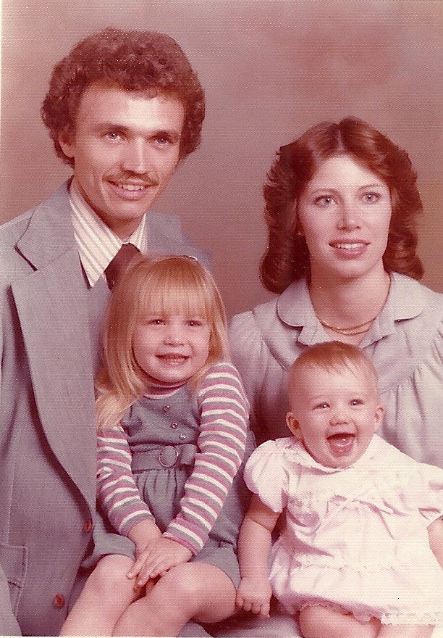
John & Darlene
Stacy & Rebecca
June 23, 1980

Slide 5
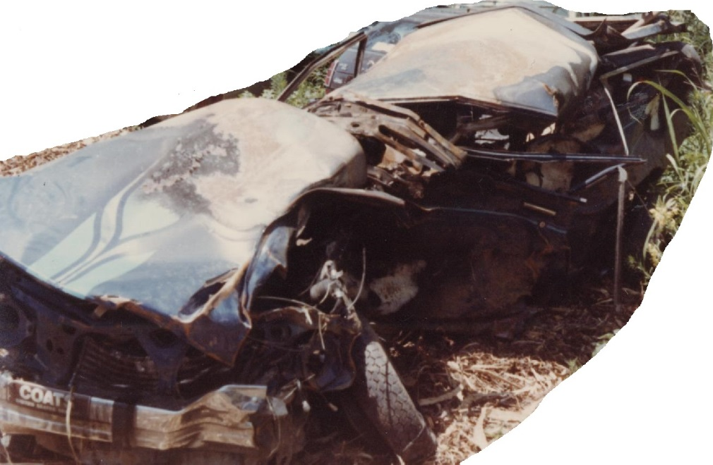
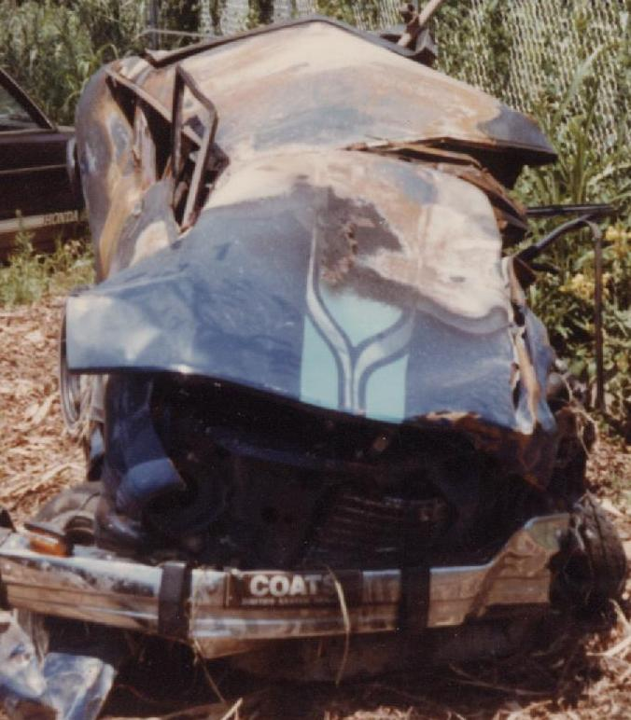
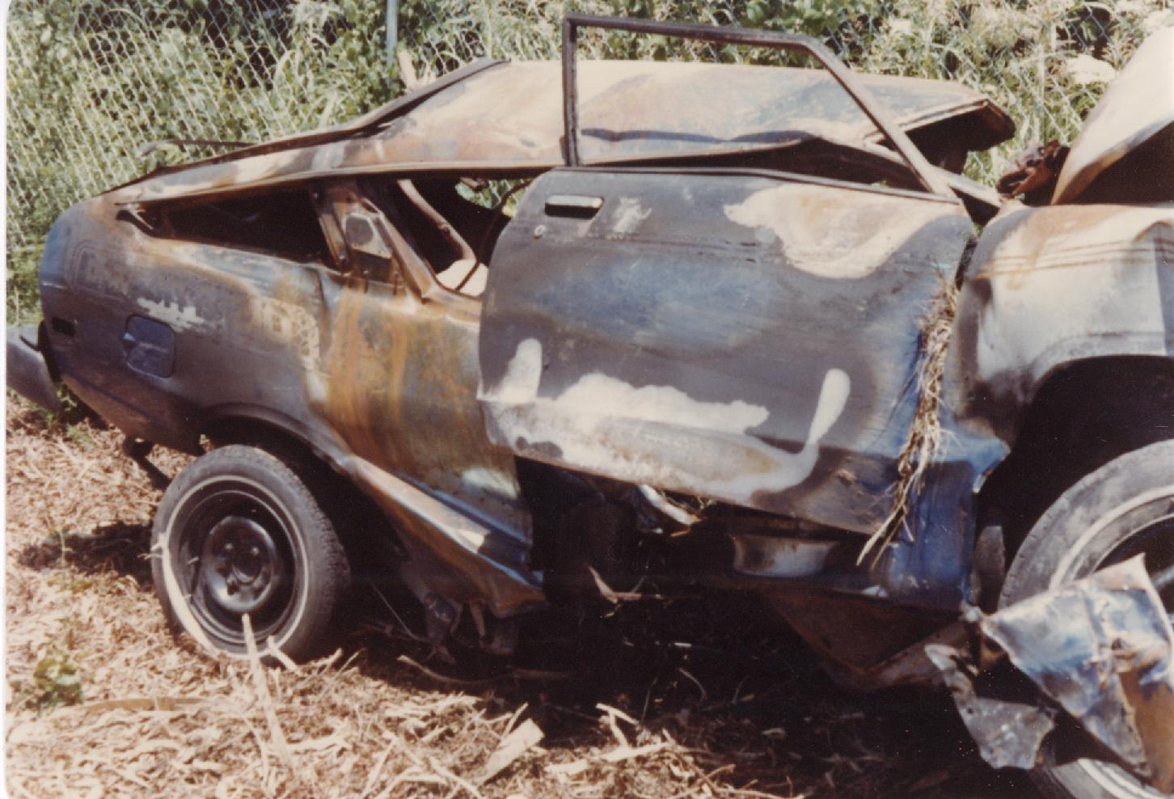

Slide 6
“God will bring us together sometime, but until then, be a good girl for mama.”
“Good-bye my love. Take good care.”

Slide 7
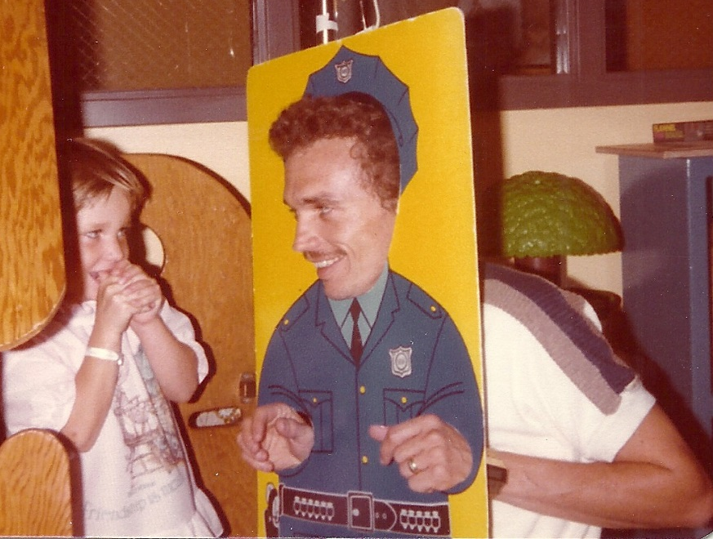
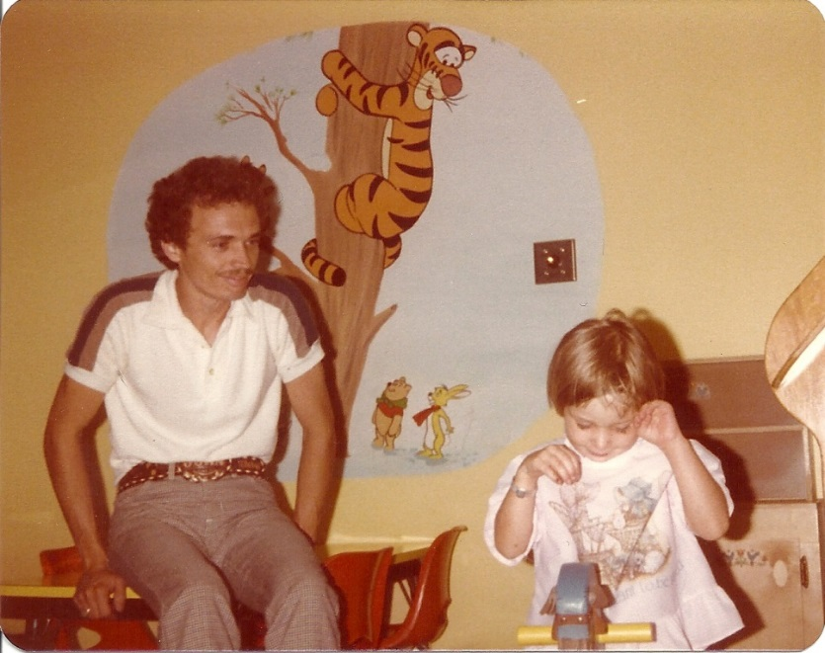
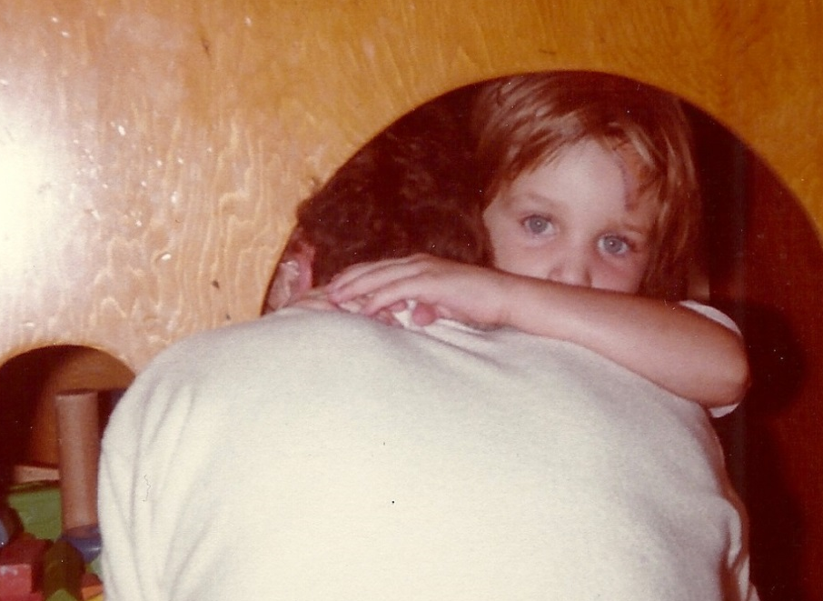

Slide 8
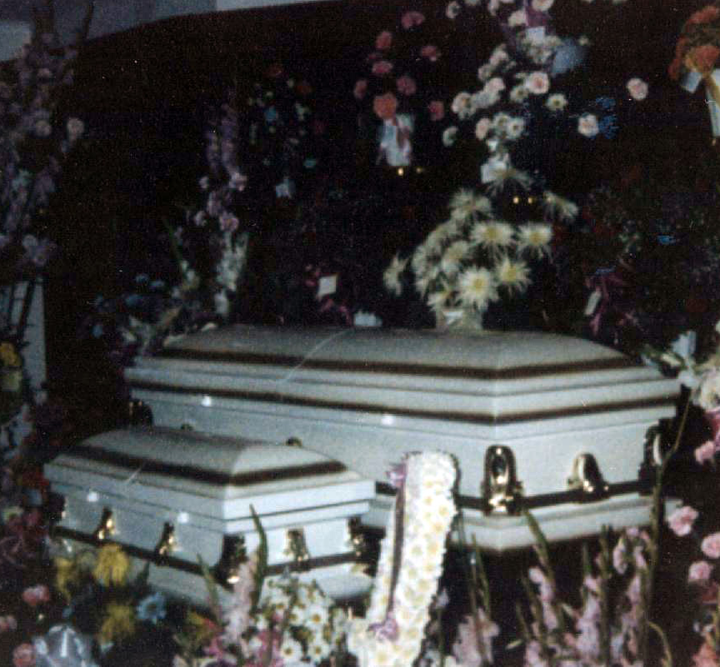
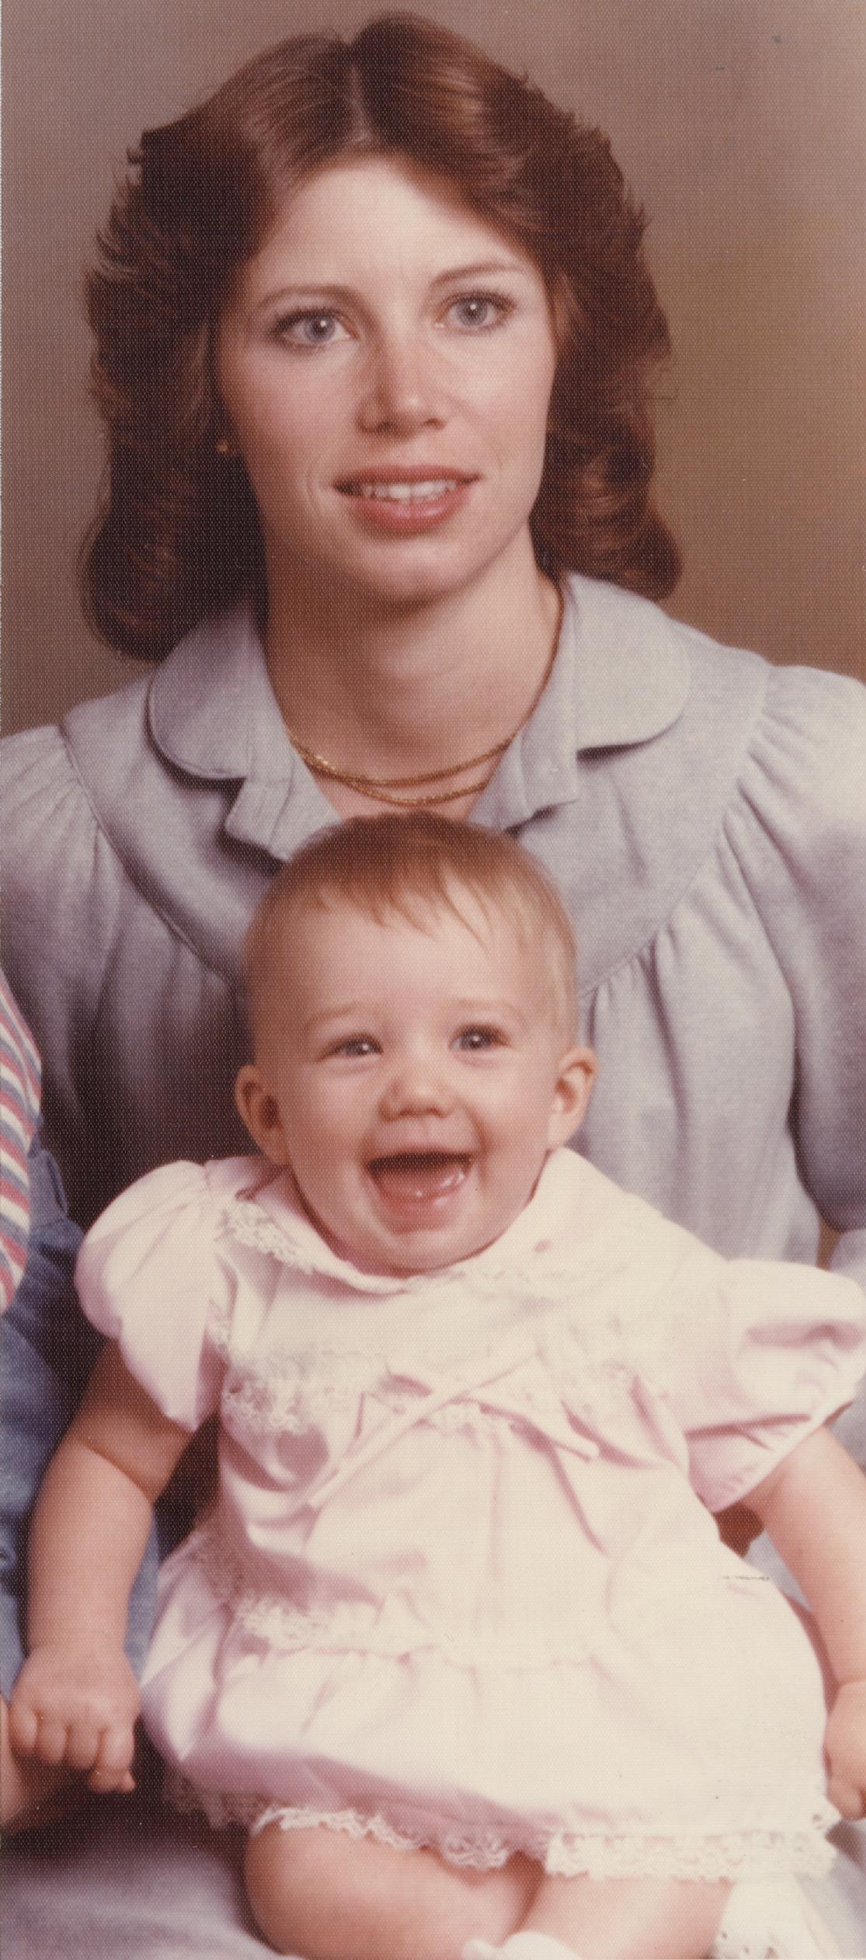
Rebecca & Darlene

Slide 9
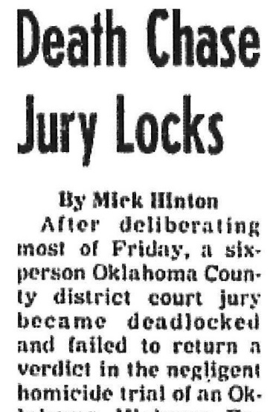

Slide 10
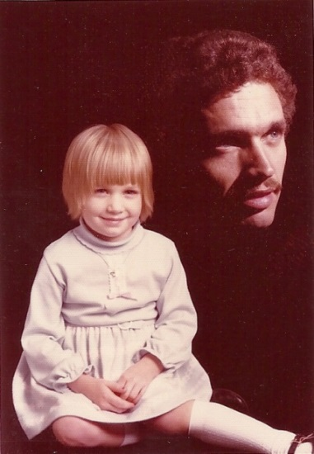
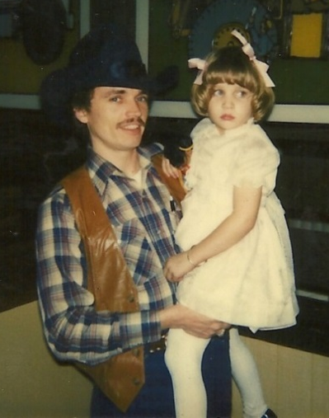
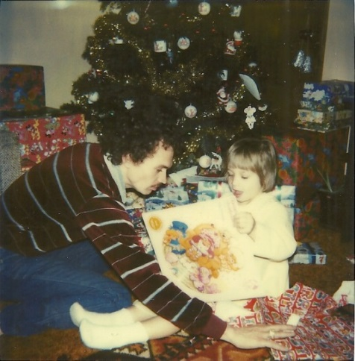
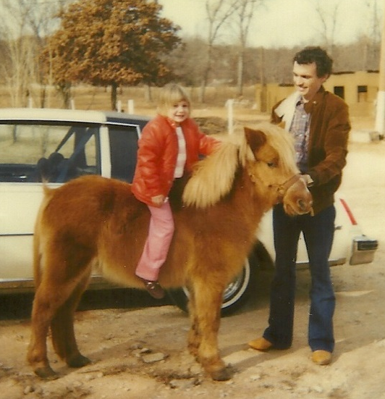
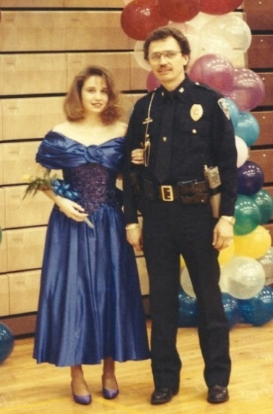
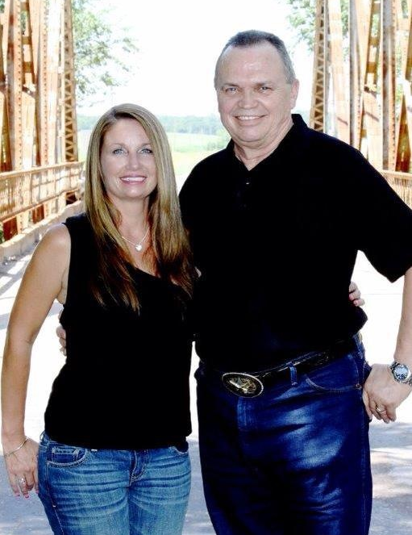
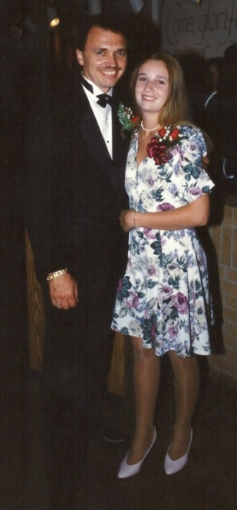
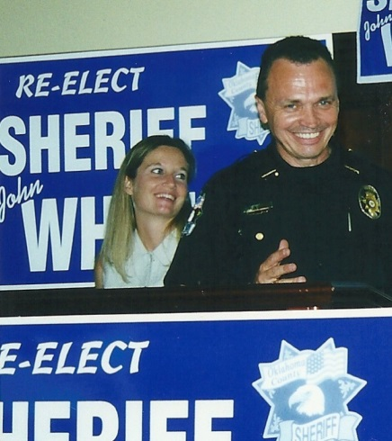

Slide 11
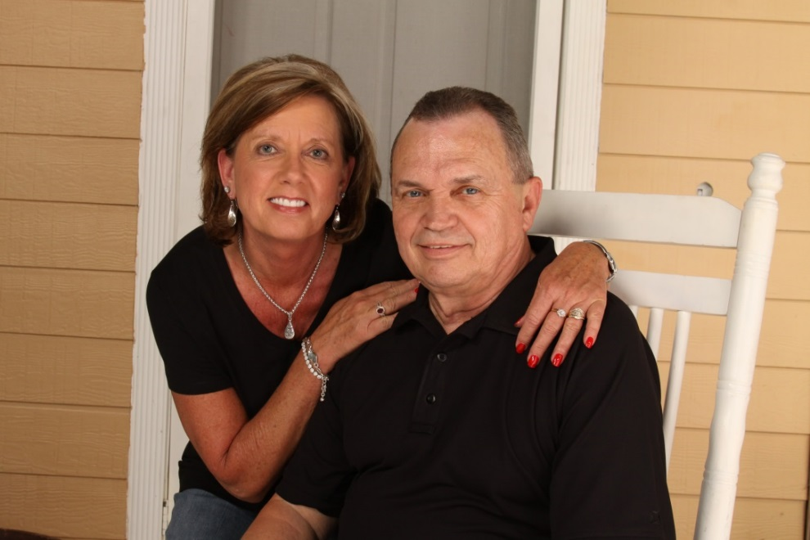
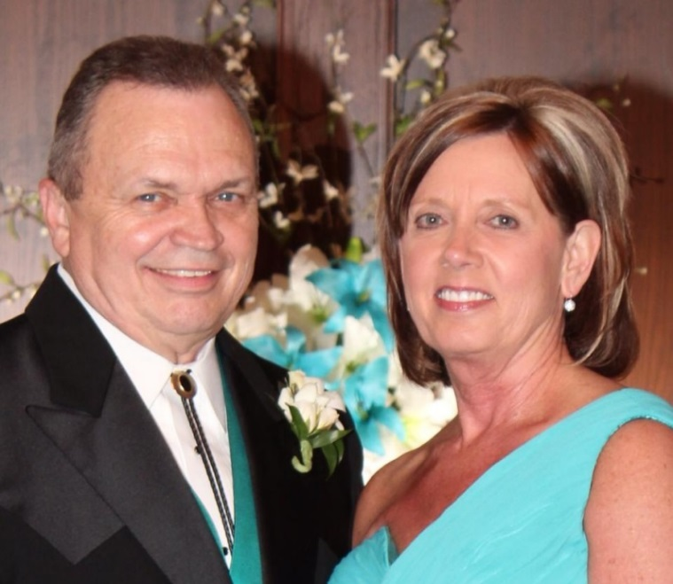
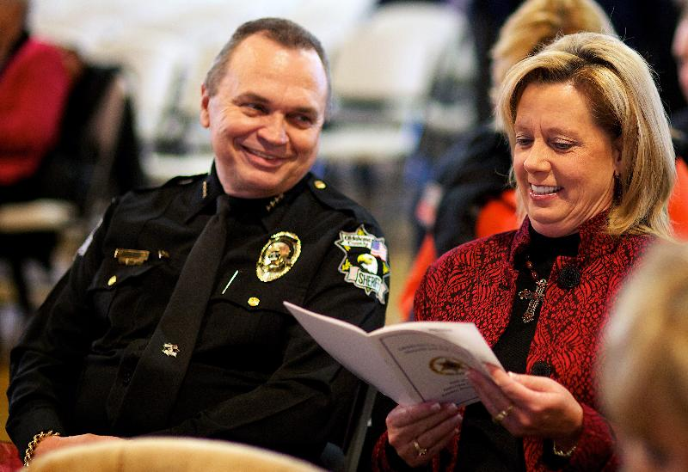

Slide 12
OCCURENCE
Vehicle crash
Two deaths and one critically injured
Recovered with life lasting injuries
Medical Examiner rules both deaths to be “homicide”
At fault driver charged with negligent homicide
Trial held that resulted in a hung jury

Slide 13
VICTIM SERVICES ?
After crash? NO
At hospital? NO
Before, during, after trial? NO
Counseling? NO
Rights explained? NO
WHY ?
The weapon was a motor vehicle
The victims / survivors were the result of car “accident”
“Accidents” are an acceptable and excusable way to die

Slide 14
CHANGE
We must change existing mind-sets
DUI and impaired driving crashes and other vehicular crimes are not “accidents”, they are “criminal acts”
victims of DUI and impaired driving crashes and other vehicular crimes:
are no less victimized
need support and services
just as much crime victims as victims of other violent crimes – only difference is the weapon used
ensure that victims of these crashes are responded to in a crime victim-centered manner

Slide 15
NSA Traffic Safety Committee & Crime Victims Services Committee
adopted joint resolution supporting inclusion of victims of criminal homicide in a traffic crash as victims of crime
Requested expansion of UCR definition
Immediate Partners
NHTSA, OVC, MADD
Support from other groups
IACP adopted a resolution of support
FBI CJIS
Sheriff Cathy Witt
Reviewing inclusion of criminal traffic crash homicides
First change since 1929
Will provide data to actually assess the need by OVC

Slide 16
REMOVE THE “A” WORD FROM YOUR VOCABULARY
Victims are not dying by “accident”
The word “accident” provides an excuse – “it’s okay”
Make an impact in your world and stop using the “A” word
IPTM and Northwestern University Center for Public Safety

Slide 17
Life isn’t about waiting
for the storm to pass …
it’s about learning to
dance in the rain.

Slide 18
Treating Victims of DUI/Impaired Driving Crashes as Crime Victims

